Slide 1

DriverPass System Analysis
Brooke Slampak
Notes:
[No speaker notes required for this slide.]

Slide 2
System Requirements
Functional Requirements:
The system shall allow students to register online with their personal and payment info.
The system shall be up-to-date with the latest DMV rules, policies, and include exams and sample questions for students to practice.
Nonfunctional Requirements:
The system will be web-based and accessible on PC and mobile devices.
The system should be available 99.9% of the time with minimal downtime.
Notes:
DriverPass will let students sign up online with their personal and payment info, making it quick and easy to get started. It’ll also always be updated to have the latest DMV rules, policies, and practice questions so students can be sure they’re studying the most up-to-date material. Since it’s web-based, people can use it on their PC or phone at their convenience. In addition, with 99.9% uptime, the system will be reliable for booking lessons, studying, etc., giving students and staff a hassle-free experience.

Slide 3
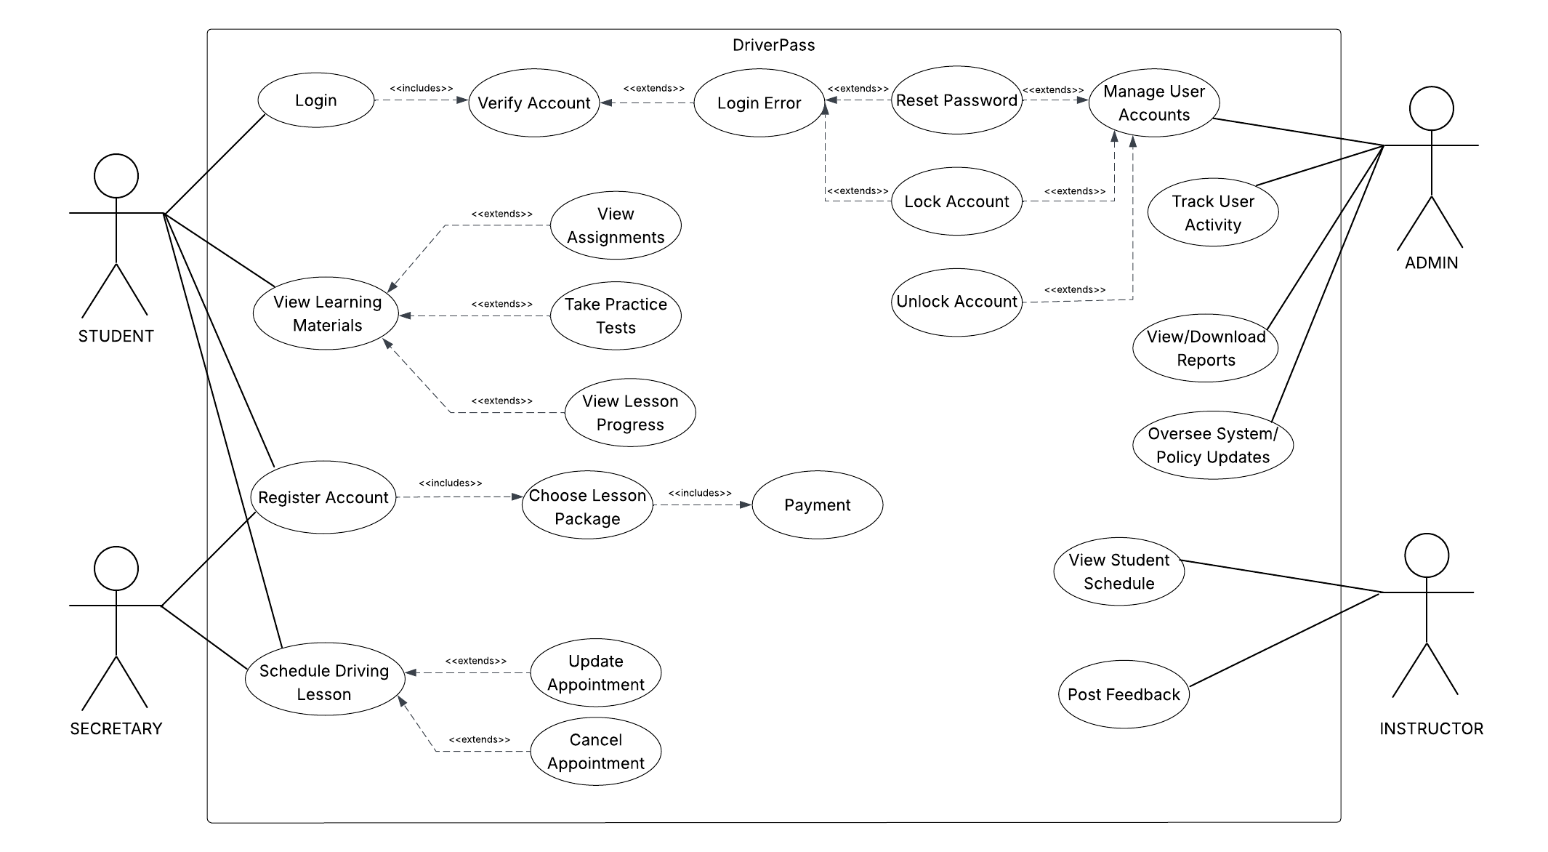
Use Case Diagram
Notes:
This diagram shows how people with different roles will use the DriverPass system and what they can do with it. Students can sign up, log in, choose a lesson package, make payments, access learning materials, take practice tests, and track their progress. They can also schedule lessons through the system. Secretaries can help schedule, update, or cancel driving lessons. Instructors can check their students’ schedules and leave feedback. Admins have the tools to manage accounts, track activity, unlock or lock accounts, run reports, and keep the system updated with the latest DMV rules and policies. The design covers all the main aspects of the DriverPass system that will make it easy for students to learn and book lessons give staff the tools to manage schedules and users.

Slide 4
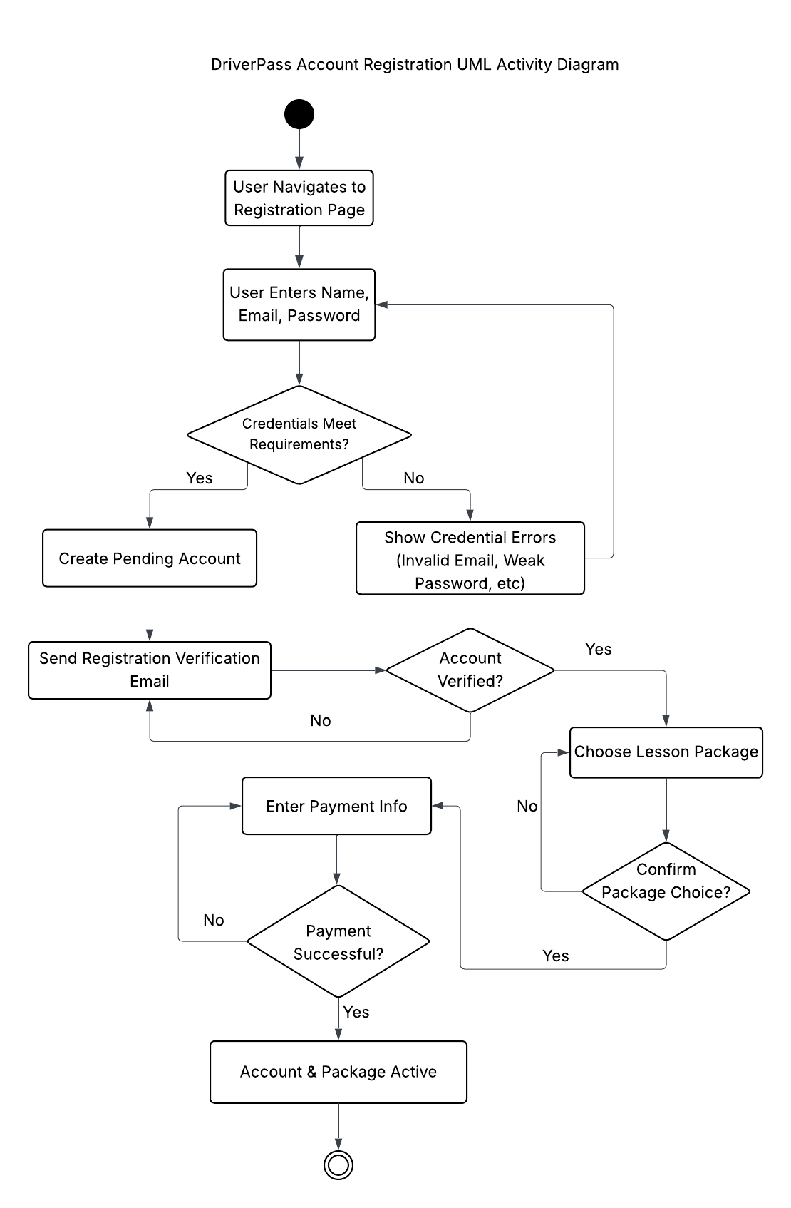
Activity Diagram
Notes:
This diagram walks through the process of how someone creates an account on the DriverPass system. It starts when the person visits the registration page and enters their name, email, and password. If what they enter meets the system’s requirements, a pending account is created, and a verification email is sent. If the information doesn’t meet requirements, they’ll see errors and have the chance to fix them. Once the account is verified, the person can choose a lesson package, confirm it, and then enter their payment details. If the payment goes through, the account and package become active. This design supports DriverPass’s needs by making sign-up simple but secure, ensuring only valid accounts are created, letting people choose and pay for packages right away while guiding them step-by-step.

Slide 5
Security
Logging in will require a username/email and password
All data will be sent securely using HTTPS
If someone types a wrong password too many times, the system will lock them out
If a user forgets their password, they can reset it by getting a secure email link
Passwords will be stored using encryption and hashing
Notes:
I have outlined several commonsense protections. First, users have to sign in with a username or email plus a secure password. All information sent between a user’s device and the site travels through a safe “tunnel,” so outsiders cannot intercept the data. If someone keeps guessing the wrong password, the account gets temporarily locked to stop break-in attempts. If a person forgets their password, they can safely start over with a one-time recovery link sent to their email. And behind the scenes, passwords aren’t stored in plain text, they’re saved in a scrambled, unreadable form, so even if someone got hold of the database, they still couldn’t see anyone’s real password.

Slide 6
System Limitations
Customizing training packages beyond turning them on or off will be beyond the scope of admins and will require code change
Functionality depends on the reliability of the cloud provider and third-party tools
If the DMV system doesn’t provide updates in a usable way, integration will be tricky
This iteration of the system will only include features discussed in the interview; Extra features will have to be made at a later time
Testing time is only 10 days, limiting the amount of time the developers have to make changes based on new requests that may arise
Notes:
Only admins can only turn training packages on or off, but anything more complicated would need the developers to change the code. The system’s performance also depends on outside services, such as the cloud provider and other tools, so if they go down, some features might not work. Getting updates from the DMV could be challenging if their system doesn’t share information in a way we can use easily. For now, the system is sticking to the features that were talked about in the interview, with any extra ideas saved for later. And since there’s only 10 days for testing, developers won’t have much time to make changes if new requests arise during that phase.

